Slide 1
Data Science and Artificial Intelligence Introduction

Slide 2
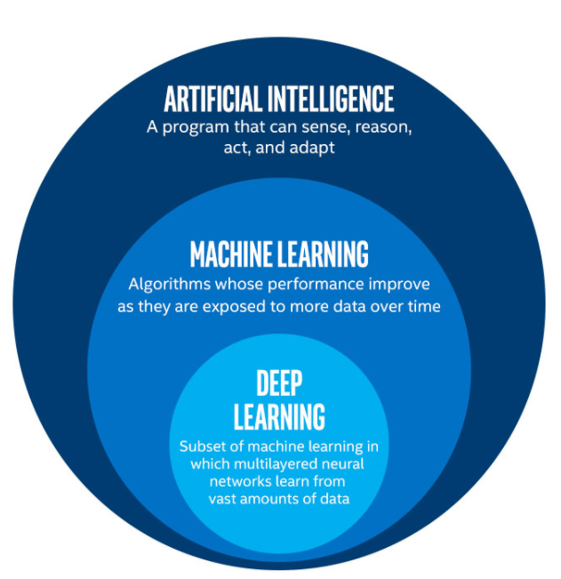
What is Artificial Intelligence?
AI is not just machine learning, and machine learning is not just deep learning!

Slide 3
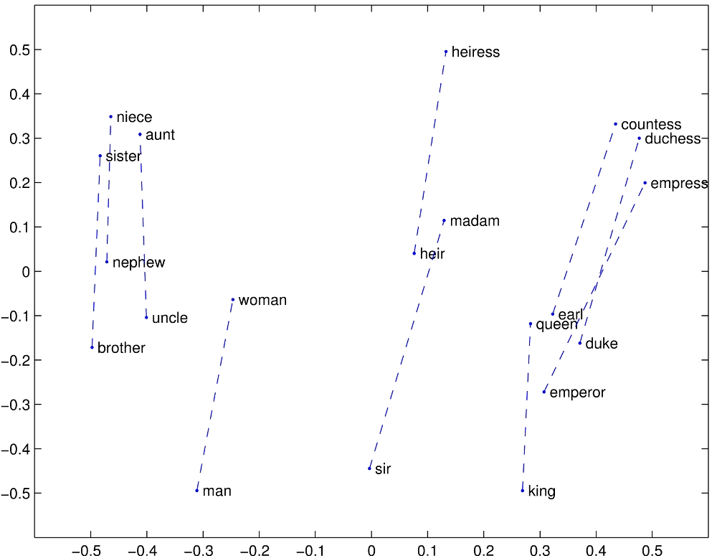
Different types of data: Text data
Source: https://nlp.stanford.edu/projects/glove/

Slide 4
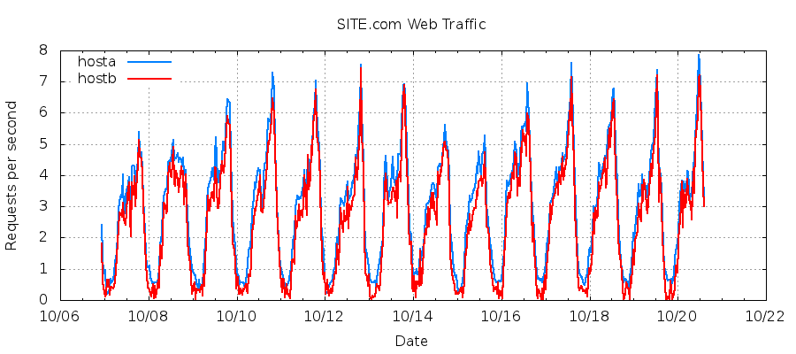
Different types of data: Time Series Data

Slide 5
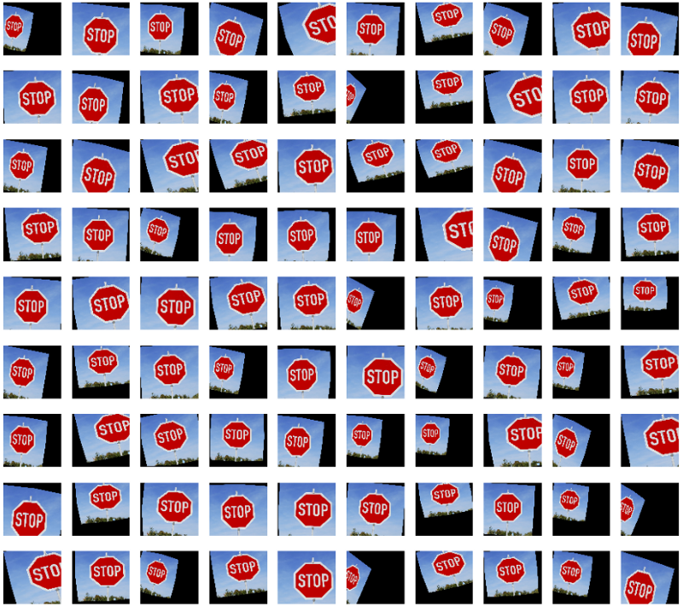
Different types of data: Image Data

Slide 6
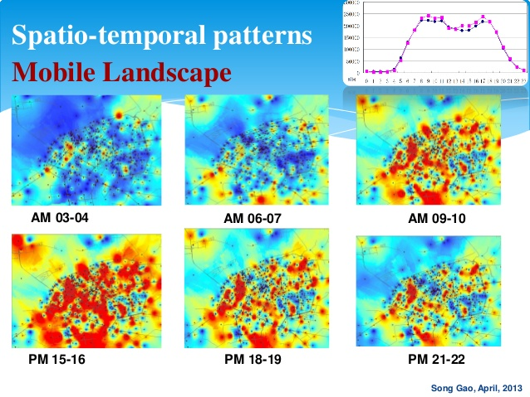
Different types of data: Spatio-temporal Data

Slide 7
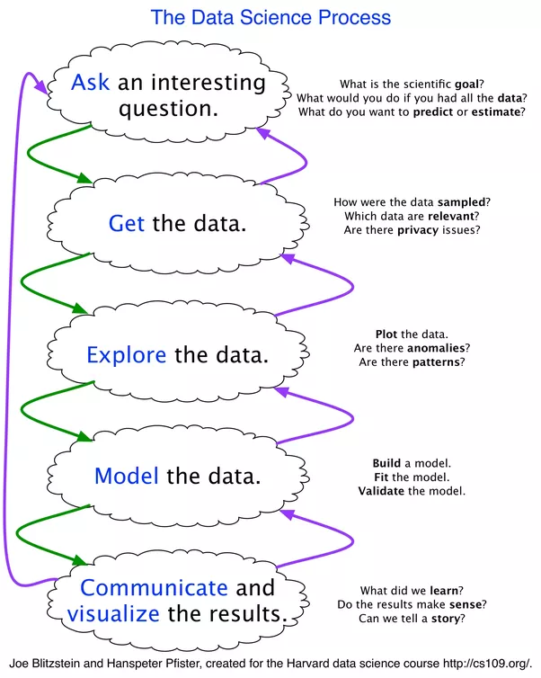
Data Science Workflow

Slide 8
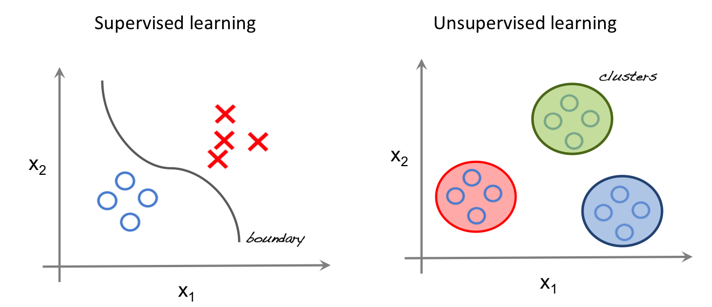
Supervised vs Unsupervised Learning

Slide 9
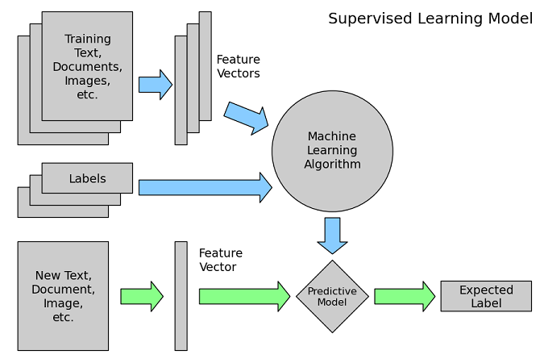
Supervised Learning Process

Slide 10
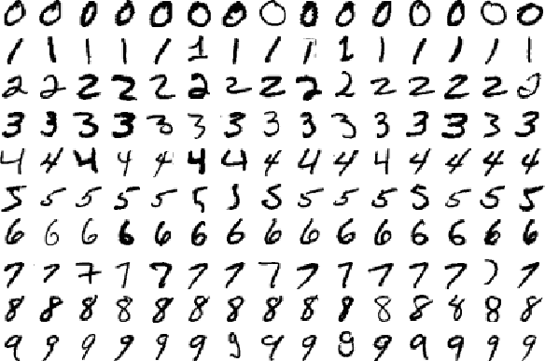
Working example – Simple Image Classification
The MNIST database of handwritten digits (http://yann.lecun.com/exdb/mnist/) has a training set of 60,000 examples, and a test set of 10,000 examples.

Slide 11
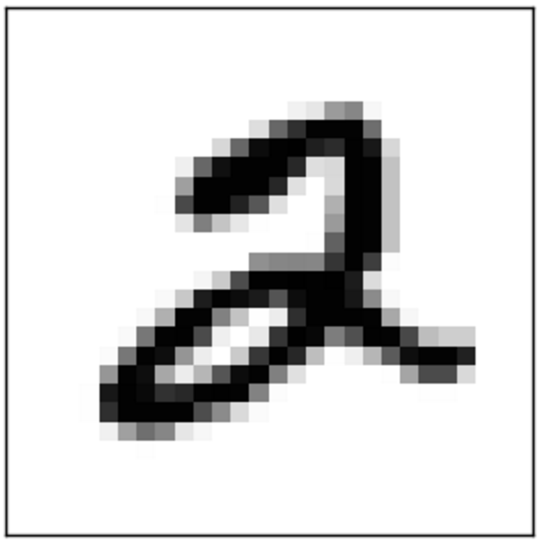
Image as input
Notes:
Image being made up of pixels –> in this simple example, feeding in the grayscaled intensity values of each pixel as a vector

Slide 12


Loss function in a softmax classifier
Cross-entropy loss
Softmax function
Notes:
we are using the notation fj to mean the j-th element of the vector of class scores f
the full loss for the dataset is the mean of Li over all training examples together with a regularization term R(W)
softmax function: It takes a vector of arbitrary real-valued scores (in z) and squashes it to a vector of values between zero and one that sum to one.
can be interpreted as the (normalized) probability assigned to the correct label yi given the image xi and parameterized by W

Slide 13
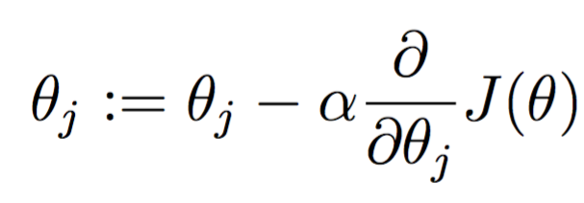
Minimizing the loss function – Gradient Descent
Compute the best direction along which we should change our weight vector that is mathematically guaranteed to the direction of steepest descent
This direction is based on the gradient of the loss function – we update the weights in the negative direction of the gradient, since we want to minimize the loss function

Slide 14
Mini-batch gradient descent
In most deep learning models, you have training data with millions of examples –> very slow to compute the loss function over all the training data, just to perform a single parameter update
This term sometimes used interchangeably with Stochastic gradient descent (SGD), but to be precise, SGD refers to doing a parameter update with each training example

Slide 15
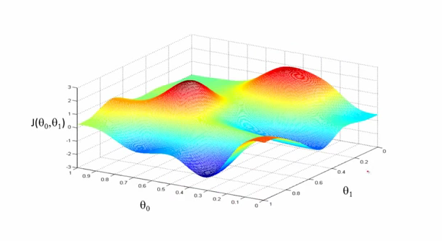
Problems faced with optimizing gradient descent
Vanilla gradient descent is susceptible to local minima in non-convex functions
Source: Andrew Ng, Stanford CS229

Slide 16
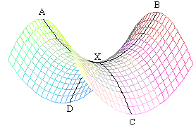
Problems faced with optimizing gradient descent
Notes:
Saddle points where one dimension slopes up and another dimension slopes down. The saddle points are usually surrounded by a plateau of the same error, which makes it notoriously hard for SGD to escape, as the gradient is close to zero in all dimensions

Slide 17
Different gradient descent optimization algorithms
Momentum – adds a fraction of the update vector of the previous time step to the current update vector
Nesterov accelerated gradient – using the momentum term to approximate the next position of the parameters, giving prescience to where the parameters are going to be
Adaptive learning rate methods – eg. Adagrad (adapts the learning rate to the parameters, performing larger updates for infrequent parameters and smaller updates for frequent parameters), Adadelta, RMSprop and Adam
Notes:
Adagrad parameter update example: eg. Frequent words vs infrequent words for GloVe word embeddings, as infrequent words require much larger updates than frequent ones. Useful for sparse data
In its update rule, Adagrad modifies the general learning rate η at each time step t for every parameter θi based on the past gradients that have been computed for θi
Adagrad’s main weakness is its accumulation of the squared gradients in the denominator: Since every added term is positive, the accumulated sum keeps growing during training. This in turn causes the learning rate to shrink and eventually become infinitesimally small, at which point the algorithm is no longer able to acquire additional knowledge. The other adaptive learning rate methods attempt to address Adagrad’s weakness
Adaptive Moment Estimation (Adam) is the most widely used gradient descent optimiser right now – it keeps an exponentially decaying average of past gradients, and incorporates bias correction in it, helping it outperform others like RMSprop towards the end of optimization as gradients become sparser

Slide 18
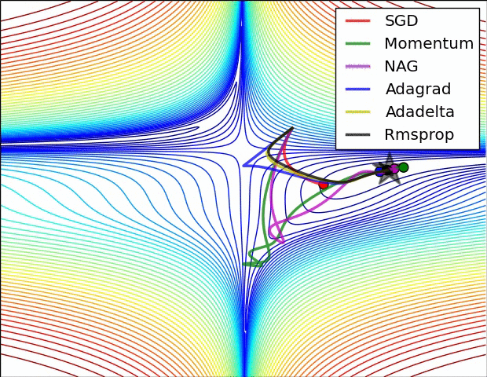
Optimizing gradient descent
Source: Alec Radford
Notes:
Loss surface contour – Adagrad, Adadelta and RMSprop headed off immediately in the right direction and converged similarly fast, while Momentum and NAG were led off track, though NAG was able to correct its course sooner due to its increased responsiveness by looking ahead

Slide 19
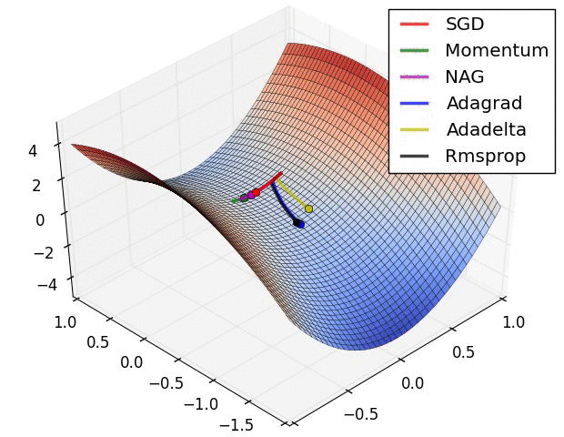
Optimizing gradient descent
Source: Alec Radford
Notes:
SGD, momentum and NAG find difficulty breaking out of the saddle point, while Adagrad, RMSprop and Adadelta quickly headed down the negative slope

